Slide 1
Communication Management
PMI Knowledge Areas

Slide 2
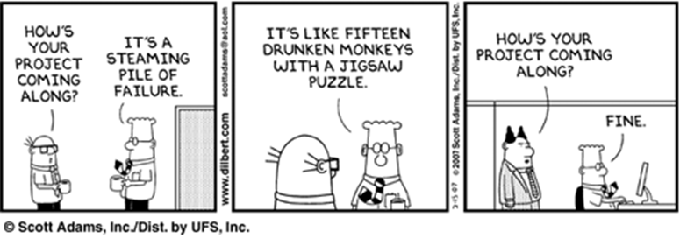
Importance of Good Communications
A threat to many projects is a failure to communicate
Strong verbal and non-technical skills are a key factor in career advancement for IT professionals

Slide 3
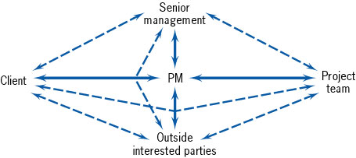
Importance of Good Communications
Communication Paths Between a Project’s Parties-At-Interest

Slide 4
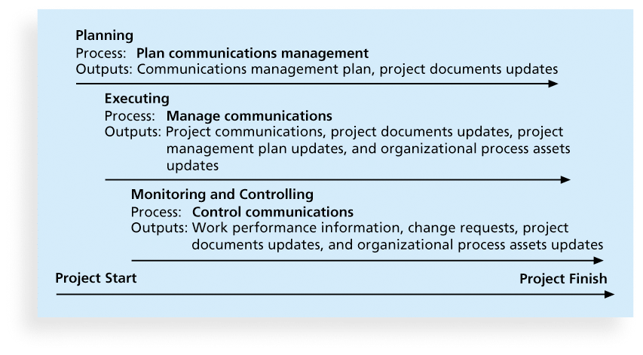
Project Communications Management Processes
Planning Communications management
Managing communications
Controlling communications

Slide 5
Keys to Good Communications
~80-90% of a PM’s time spent communicating
Focus on needs – both group and individual
Mix methods - formal and informal
Set the stage for communicating bad news
Distribute important information in an effective and timely manner
Determine the number of communication channels

Slide 6
Communications Channels
As the number of people involved increases, the complexity of communications increases because there are more communications channels or pathways through which people can communicate.
Number of communications channels = n(n-1)
2 where n is the number of people involved

Slide 7
Planning Process Group: Planning Communications Mgmt
Every project should include some type of communications management plan, a document that guides project communications
Determine the four Ws
Sample Project Management Plan

Slide 8
Communications Management Plan Contents
Stakeholder communications requirements
Suggested methods or technologies for conveying the information
Escalation procedures for resolving issues
Revision procedures for updating the communications management plan
A glossary of common terminology

Slide 9
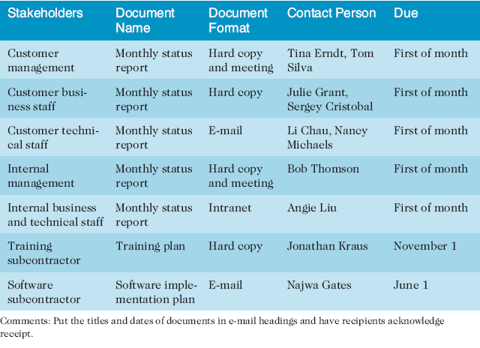
Sample Stakeholder Analysis for Project Communications

Slide 10
Communication Technology Determination
Factors contributing to determining the communication technology to be used:
Availability
Project environment
Project Length
Urgency
Preparation Level

Slide 11
Importance of Face-to-Face Communication
Communication needs to be adjusted depending on the channel
How should you approach communication
Short, frequent meetings are often very effective in IT projects

Slide 12
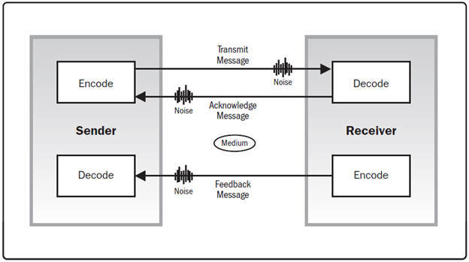
Communication Model

Slide 13
Communication Model

Slide 14
Exercise: Communication Model
You are the project manager for a large SAP implementation. Match the parts of the communication model to the different actions below (Message, Medium, Encode, Noise, Receiver, Feedback):
While developing the schedule, you realize that there was a risk involved in the project. So, you put your thoughts in a note to be sent out shortly.
You send that note to your project sponsor
You used email to send the message
The sponsor received the message
The sponsor could not understand some of the acronyms and terms in the email message
The sponsor responded to you, expressing his concern that he could not exactly understand your concerns

Slide 15
Executing Process Group: Managing Communications
Managing communications is a large part of a project manager’s job
Important considerations include:
Technology
Appropriate methods and media to use
Performance reporting

Slide 16
Distributing Information
Distribution Methods
Distribution Tools
Distribution of Information

Slide 17
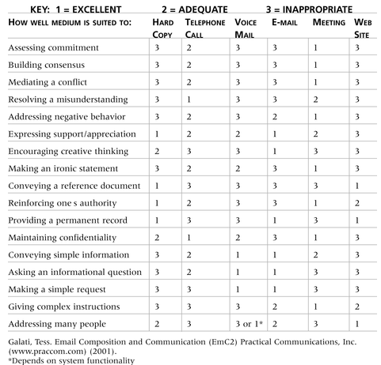
Classifications for Communication Methods
Interactive
Push
Pull

Slide 18
Distributing Information in an Effective and Timely Manner
Don’t bury crucial information
Don’t be afraid to report bad information
Oral communication via meetings and informal talks helps bring important information—good and bad—out into the open

Slide 19
Setting the Stage for Communicating Bad News
Dear Mom and Dad, or should I say Grandma & Grandpa,
Yes, I am pregnant. No, I’m not married yet since Larry, my boyfriend, is out of a job. Larry’s employers just don’t seem to appreciate the skills he has learned since he quit high school. Larry looks much younger than you, Dad, even though he is three years older. I’m quitting college and getting a job so we can get an apartment before the baby is born. I found a beautiful apartment above a 24-hour auto repair garage with good insulation so the exhaust fumes and noise won’t bother us.
I’m very happy. I thought you would be too.
Love, Ashley
P.S. There is no Larry. I’m not pregnant. I’m not getting married. I’m not quitting school, but I am getting a “D” in Chemistry. I just wanted you to have some perspective.

Slide 20
Reporting Performance
Performance reporting keeps stakeholders informed about how resources are being used to achieve project objectives
Status reports
Progress reports
Forecasts

Slide 21
Monitor/Control Process Group: Controlling Communications
The main goal of controlling communications is to ensure the optimal flow of information throughout the entire project life cycle
The project manager and project team should use their various reporting systems, expert judgment, and meetings to assess how well communications are working.
If problems exist, the project manager and team need to take action, which often requires changes to the earlier processes of planning and managing project communications

Slide 22
Suggestions for Improving Project Communications
Develop better communication skills
Run effective meetings
Use e-mail and other technologies effectively
Use templates for project communications

Slide 23
Developing Better Communication Skills
Most companies spend a lot of money on technical training for their employees, even when employees might benefit more from communications training
It takes leadership to improve communication

Slide 24
Running Effective Meetings
Determine if a meeting can be avoided
Define the purpose and intended outcome of the meeting
Determine who should attend
Provide an agenda before meeting
Set the ground rules for the meeting
Cost of Meetings

Slide 25
Using E-Mail, Instant Messaging, Texting, and Collaborative Tools Effectively
Make sure that e-mail, instant messaging, texting, or collaborative tools are an appropriate medium for what you want to communicate
Be sure to authorize the right people to share and edit your collaborative documents

Slide 26
Other Communication Considerations
Rarely does the receiver interpret a message exactly as the sender intended
Geographic location and cultural background affect the complexity of project communications
Different working hours
Language barriers
Different cultural norms

Slide 27
Using Templates for Project Communications
Many technical people are afraid to ask for help
Providing examples and templates for project communications saves time and money
Organizations can develop their own templates, use some provided by outside organizations, or use samples from textbooks
Recall that research shows that companies that excel in project management make effective use of templates

Slide 28
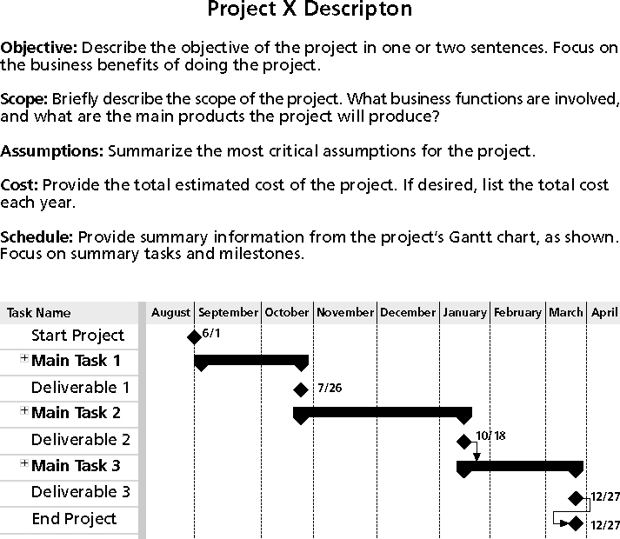
Sample Template for a Project Description

Slide 29
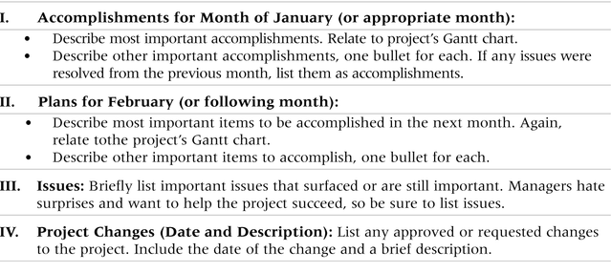
Sample Template for a Monthly Progress Report

Slide 30
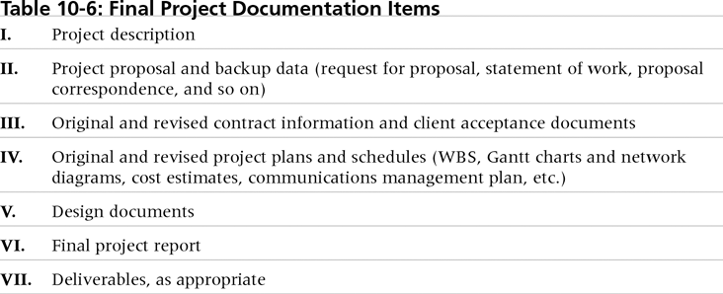
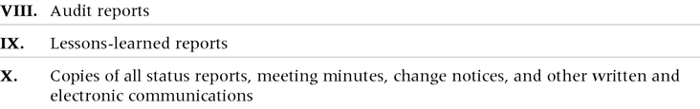
Final Project Documentation Items

Slide 31
Lessons Learned Reports & Archives
The project manager and project team members should each prepare a lessons-learned report
Project archives are a complete set of organized project records that provide an accurate history of the project
These archives can provide valuable information for future projects as well

Slide 32
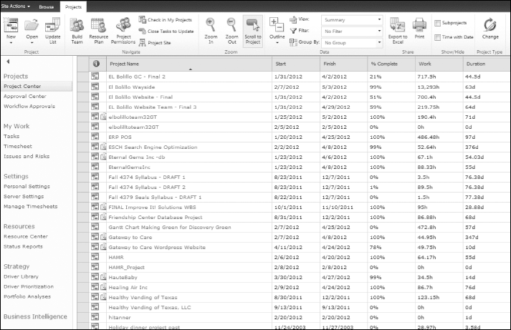
Project Web Sites
Many project teams create a project Web site to store important product documents and other information
Microsoft’s Project Web Application Master Project Summary Screen

Slide 33
Best Practice
Alaska Airlines uses secure project wikis to facilitate project communications and collaborations
Benefits include:
Better documentation
Improved trust and information sharing
Sustained growth
The Alaska Airlines IT department even created a “Mother of All Wikis” to serve as an index for all the known project wikis

Slide 34
Chapter Takeaways
Communication should run throughout the project. This is why the communication plan is so important.
Goal: deliver the right information to the right people at the right time
The work performance measures communicated can have impacts throughout the knowledge areas including scope, time, cost and quality

